Slide 1
Botanical Crop Protection Products with a Difference
EF300 | Insecticide
EF400 | Fungicide
BacStop | Bactericide/Fungicide
SoilShot | Nematicide/Fungicide

Slide 2
Botanical Extract Chemistry
Plants make scent producing compounds called:
Monoterpenes, Phenols, Oxides, Esters, Aldehydes, Ketones and Sesquiterpenes.
Plants use these compounds naturally for protection from pests, diseases.
We can extract them and concentrate them into organic crop protection products since they are naturally occurring and food grade compounds.
What are the Active Ingredients

Slide 3
Known Modes of Action of Botanical Plant Extracts
Neurotoxicity
Regulation of insect growth
Deterioration of insect waxy cuticle/exoskeleton
Impede digestive enzymes in insects
Inhibition of some internal plant biological functions
Dissolve and disrupt the integrity of cell walls and membranes on fungi
Ovicide and Oviposition Inhibitor
Repellency and anti feeding properties

Slide 4
GreenFurrow Botanical Extracts Are Not Toxic to Humans and Animals
Humans and animals do not have the proteins or cell structure that insect, fungi and bacteria have that botanical crop protection formulations attack and kill.

Slide 5
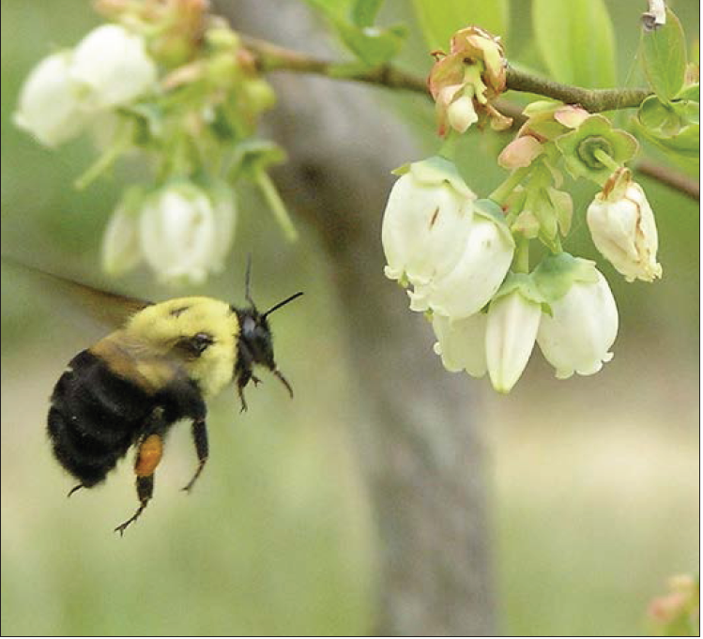
PROTECTION OF BEES AND BENEFICIALS
The GreenFurrow crop protection products are designed to not harm bees.
Unfortunately, even pesticides allowed for use in organic agriculture can cause harm to bees and other beneficial insects. There are many considerations when choosing between different pesticide options including efficacy, specificity, cost and risk to the environment.

Slide 6
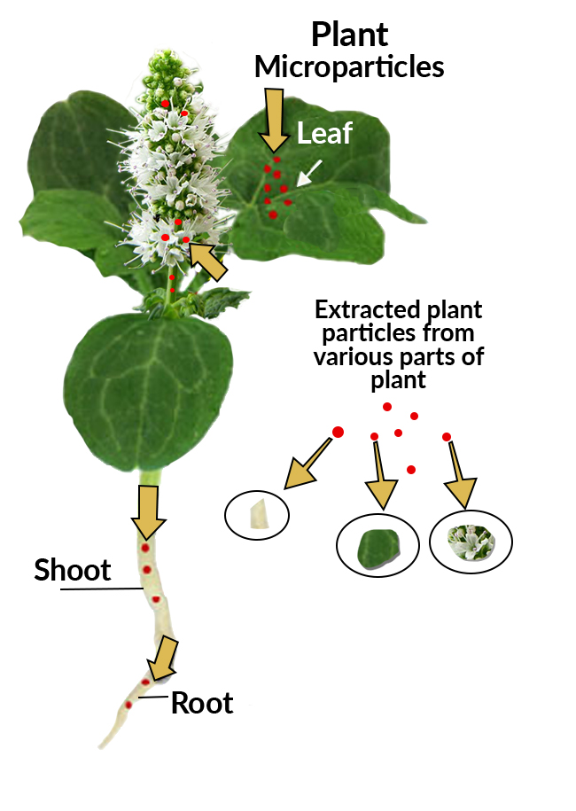
OUR TECHNOLOGY
EF300, EF400, BacStop and SoilShot are natural formulations, developed by using food-grade active ingredients derived from specific microparticles of plants.
There are no essential oil components used as active ingredients in the GreenFurrow Organic Crop Protection Products.
The extracted plant microparticle’s emulsify and encapsulate when water is added.

Slide 7
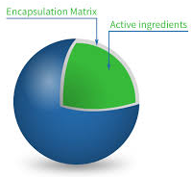
KEY BENEFITS OF MICRO-PARTICLE ENCAPSULATION
Active ingredients are delivered in precise concentrations with even coverage and are not affected by temperature or evaporation rates providing consistent performance
Lower dilution rates provide better economies
Oils in formulations are used as binders, carriers and spreaders, and provide no other function.
These proprietary formulations provide consistent & predictable performance when used as directed and within a broad temperature range of 40F to 90F.
Microencapsulation
Active Ingredients
Multilayer Liquid
Crystalline Microsphere
Encapsulation Matrix
Active Ingredients

Slide 8
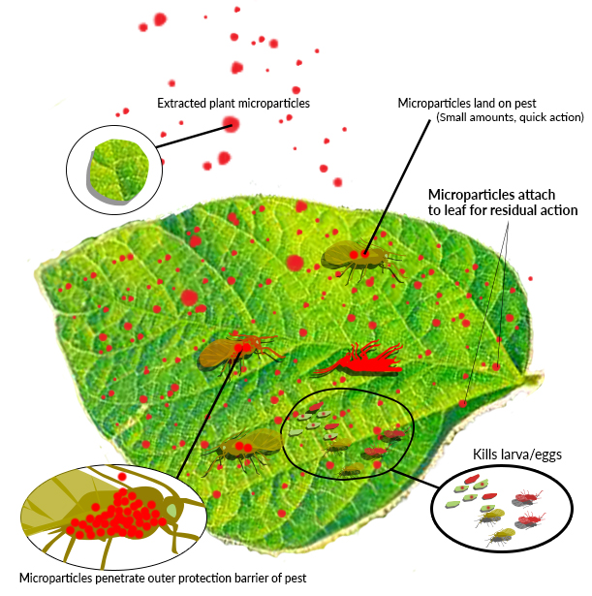
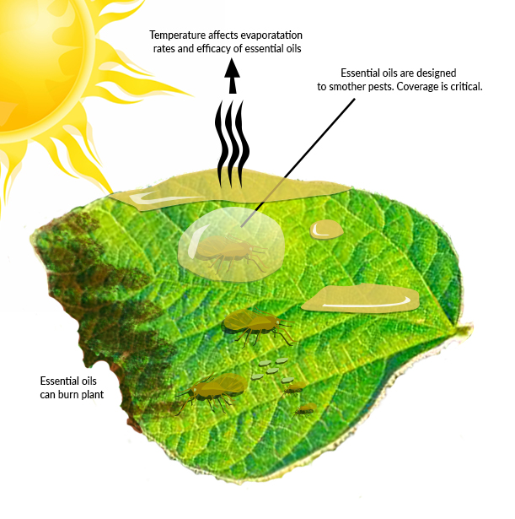
GreenFurrow Crop Protection Technology Versus Oils
Extracted Plant Particles
Essential Oil Formulations

Slide 9
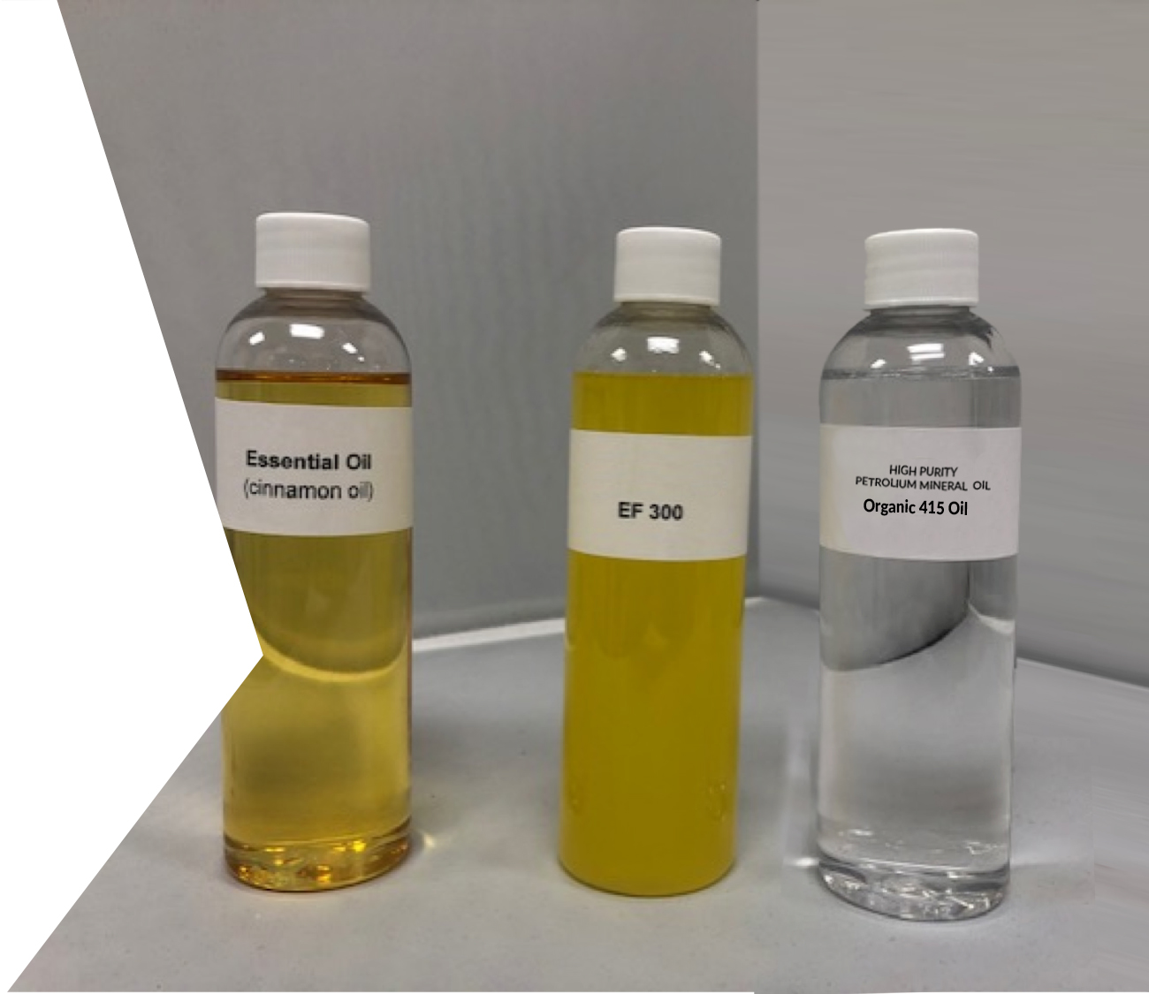
KEY DIFFERENCES – FORMULATIONS
The GreenFurrow Crop Protection formulations can be easily recognized as different from essential oil blends. The cloudy appearance is due to the light refracting off plant micro particles rather than passing through oils molecules.

Slide 10
GreenFurrow EF 300, EF 400, BacStop and Soil Shot are registration exempt under sec. 25b of the Federal Insecticide, Fungicide and Rodenticide Act.

Slide 11
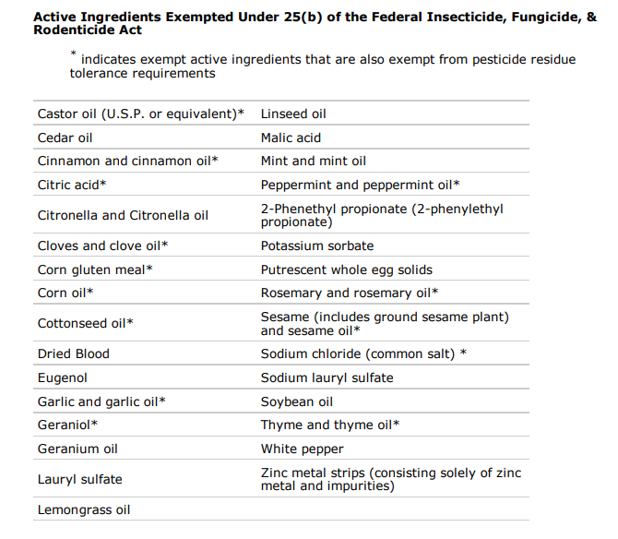
25(b)
List of ingredients that fall under 25(b) EPA and DPR exemption

Slide 12
GreenFurrow products are designed to perform the same each time when applied and regardless of temperatures.

Slide 13
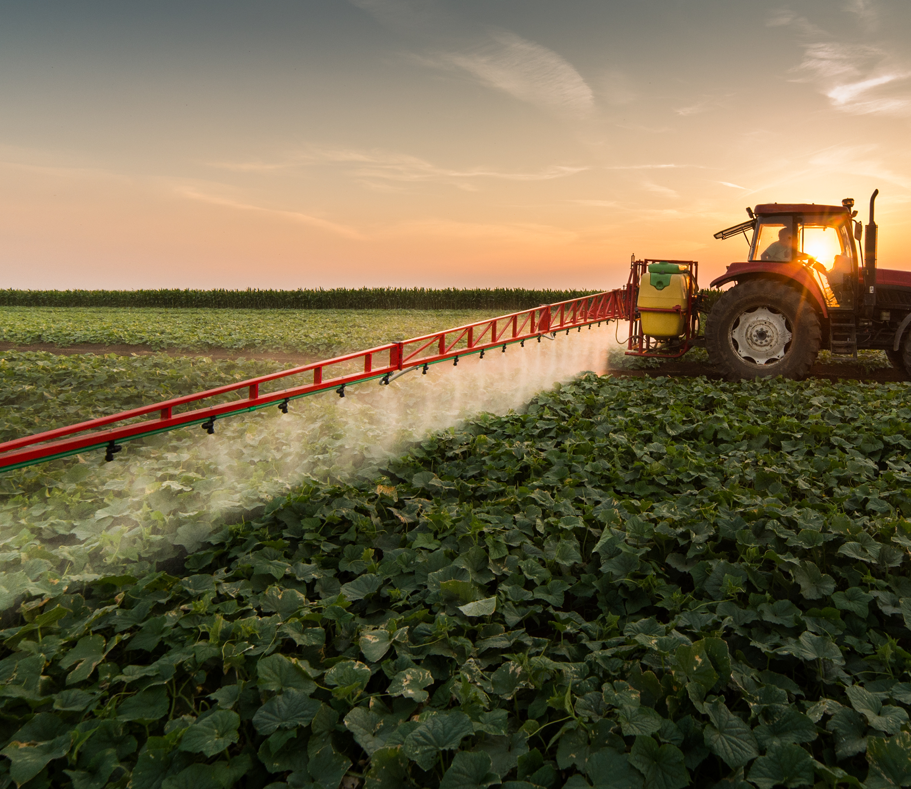
EF300 Insecticide
EF400 Fungicide

Slide 14
EF300 Insecticide
Designed to kill adults, eggs and larvae. In many cases, population controls are managed by controlling egg and larvae stage.
Effective life of EF300 is approximately 7 days and effective control can last several weeks.
Ideally suited for Aphid, Mites, White Fly and Psyllids
Can be applied by ground or aerial application.
Foliar application use rate of 0.25%-1.0%v/v spray solution

Slide 15
EF400 Fungicide
Broad spectrum fungicide used extensively throughout the vegetable and fruit industry
Provides maximum disease protection with both curative and preventative actions.
Ideal for Anthracnose, Aspergillus, Botrytis, Powdery Mildew, Downey Mildew, Grey molds
Can be applied by ground or aerial application.
Foliar application use rate of 0.25%-1.0%v/v spray solution

Slide 16
Mixing Rates Per Acre
Use Rate per 100 Gallons
EF300 & EF400
32 fl. oz. to 128 fl. oz.
0.25%-1.00% concentration V/V
Aerial Application
Apply 24 to 32 fl. oz per acre. Use a pH of 6.0 to 7.0
24.3 fl. oz to 32 fl. oz
0.19%-0.25% concentration V/V

Slide 17
EF300 Insecticide / EF400 FUNGICIDE
Recommended Number of Ounces Based on gallons per acre
Total | 0.25% |  | 0.40% |  | 0.50% |  | 0.75% |  | 1.00% |  | 2.00%
Gal | oz | gal | oz | gal | oz | gal | oz | gal | oz | gal | oz | gal
5 | 1.60 |  | 2.56 |  | 3.20 |  | 4.80 |  | 6.40 |  | 12.80
10 | 3.20 | 0.02 | 5.12 | 0.04 | 6.40 | 0.05 | 9.60 | 0.07 | 12.80 | 0.10 | 25.60 | 0.20
25 | 8.00 | 0.06 | 12.80 | 0.10 | 16.00 | 0.12 | 24.00 | 0.19 | 32.00 | 0.25 | 64.00 | 0.50
50 | 16.00 | 0.12 | 25.60 | 0.20 | 32.00 | 0.25 | 48.00 | 0.37 | 64.00 | 0.50 | 128.00 | 1.00
100 | 32.00 | 0.25 | 51.20 | 0.40 | 64.00 | 0.50 | 96.00 | 0.75 | 128.00 | 1.00 | 256.00 | 2.00
$$30.00$$ | 9.60 | 0.07 | 15.36 | 0.12 | 19.20 | 0.15 | 28.80 | 0.22 | 38.40 | 0.30 | 76.80 | 0.60
Example of dilution rate per 30 gallons
See label for application details

Slide 18
BacStop Bactericide/Fungicide
SoilShot Nematicide/Fungicide

Slide 19
BacStop Bactericide/Fungicide
Used as a ”sister” product to the EF400 as a foliar spray or soil drench
Use with EF300 as effective insect control and bactericide for Psyllid control
Use with EF400 as a one-step fungus and bacteria management tool
Ideal for bacterial blights, Leaf Curl, Fusarium Wilt, Stem Canker, and Scabs and Leaf Spots

Slide 20
BacStop Bactericide/Fungicide
Recommended Number of Ounces Based on gallons per acre
Total | 0.25% |  | 0.40% |  | 0.50% |  | 0.75% |  | 1.00% |  | 2.00%
Gal | oz | gal | oz | gal | oz | gal | oz | gal | oz | gal | oz | gal
5 | 1.60 |  | 2.56 |  | 3.20 |  | 4.80 |  | 6.40 |  | 12.80
10 | 3.20 | 0.02 | 5.12 | 0.04 | 6.40 | 0.05 | 9.60 | 0.07 | 12.80 | 0.10 | 25.60 | 0.20
25 | 8.00 | 0.06 | 12.80 | 0.10 | 16.00 | 0.12 | 24.00 | 0.19 | 32.00 | 0.25 | 64.00 | 0.50
50 | 16.00 | 0.12 | 25.60 | 0.20 | 32.00 | 0.25 | 48.00 | 0.37 | 64.00 | 0.50 | 128.00 | 1.00
100 | 32.00 | 0.25 | 51.20 | 0.40 | 64.00 | 0.50 | 96.00 | 0.75 | 128.00 | 1.00 | 256.00 | 2.00
40.00 | 12.80 | 0.10 | 20.48 | 0.16 | 25.60 | 0.20 | 38.40 | 0.30 | 51.20 | 0.40 | 102.40 | 0.80
Example of dilution rate per 40 gallons

Slide 21
EF400 & BacStop Tank Mix
Recommended Individual Number of Ounces to be combined Based on gallons per acre
Total | 0.25% |  | 0.40% |  | 0.50% |  | 0.75% |  | 1.00% |  | 2.00%
Gal | oz | gal | oz | gal | oz | gal | oz | gal | oz | gal | oz | gal
5 | 1.60 |  | 2.56 |  | 3.20 |  | 4.80 |  | 6.40 |  | 12.80
10 | 3.20 | 0.02 | 5.12 | 0.04 | 6.40 | 0.05 | 9.60 | 0.07 | 12.80 | 0.10 | 25.60 | 0.20
25 | 8.00 | 0.06 | 12.80 | 0.10 | 16.00 | 0.12 | 24.00 | 0.19 | 32.00 | 0.25 | 64.00 | 0.50
50 | 16.00 | 0.12 | 25.60 | 0.20 | 32.00 | 0.25 | 48.00 | 0.37 | 64.00 | 0.50 | 128.00 | 1.00
100 | 32.00 | 0.25 | 51.20 | 0.40 | 64.00 | 0.50 | 96.00 | 0.75 | 128.00 | 1.00 | 256.00 | 2.00
40.00 | 12.80 | 0.10 | 20.48 | 0.16 | 25.60 | 0.20 | 38.40 | 0.30 | 51.20 | 0.40 | 102.40 | 0.80
Example of dilution rate per 40 gallons

Slide 22
SoilShot Nematicide/Fungicide
Highly concentrated 2 in 1 action product
Designed to return an infected root ball to good health
Protect from nematodes as a repellent
Used to enhance production in berries, fruits, grapes and nuts
Do not apply as a foliar spray
Use on plants with established roots (7-10 day after transplant)
If used as a pre-seed or transplant soil treatment, it should be applied 5 days before seeding or transplanting and watered into the soil.
Ideally suited for a drip system application
In soil application SoilShot has an effective duration of 30 days

Slide 23
SoilShot Nematicide/Fungicide
Spray Application
Recommended number of ounces for gallons per acre. Dilution rate varies according to treatment targets.
Oz / | 1.5 | oz | 2.0 | oz | 2.5 | oz | 3.0 | oz | 3.5 | oz
Gal | oz | gal | oz | gal | oz | gal | oz | gal | oz | gal
Gal Acre
30 | 45.00 | 0.35 | 60.00 | 0.47 | 75.00 | 0.59 | 90.00 | 0.70 | 105.00 | 0.82
50 | 75.00 | 0.59 | 100.00 | 0.78 | 125.00 | 0.98 | 150.00 | 1.17 | 175.00 | 1.37
75 | 112.50 | 0.88 | 150.00 | 1.17 | 187.50 | 1.46 | 225.00 | 1.76 | 262.50 | 2.05
100 | 150.00 | 1.17 | 200.00 | 1.56 | 250.00 | 1.95 | 300.00 | 2.34 | 350.00 | 2.73
See label for application details

Slide 24
SoilShot Nematicide/Fungicide
Drip Application
Injection rates varies according to plant type and disease severity. Gallons depends on recommended volume per plant.
Oz / | 1.5 | oz | 2.0 | oz | 2.5 | oz | 3.0 | oz
Gal | oz | gal | oz | gal | oz | gal | oz | gal
Gal
30 | 45.00 | 0.35 | 60.00 | 0.47 | 75.00 | 0.59 | 90.00 | 0.70
50 | 75.00 | 0.59 | 100.00 | 0.78 | 125.00 | 0.98 | 150.00 | 1.17
75 | 112.50 | 0.88 | 150.00 | 1.17 | 187.50 | 1.46 | 225.00 | 1.76
100 | 150.00 | 1.17 | 200.00 | 1.56 | 250.00 | 1.95 | 300.00 | 2.34
See label for application details

Slide 25
EF300, EF400 & BacStop work best when applied as a fine spray with high pressure. Use less with better coverage and be efficient.

Slide 26
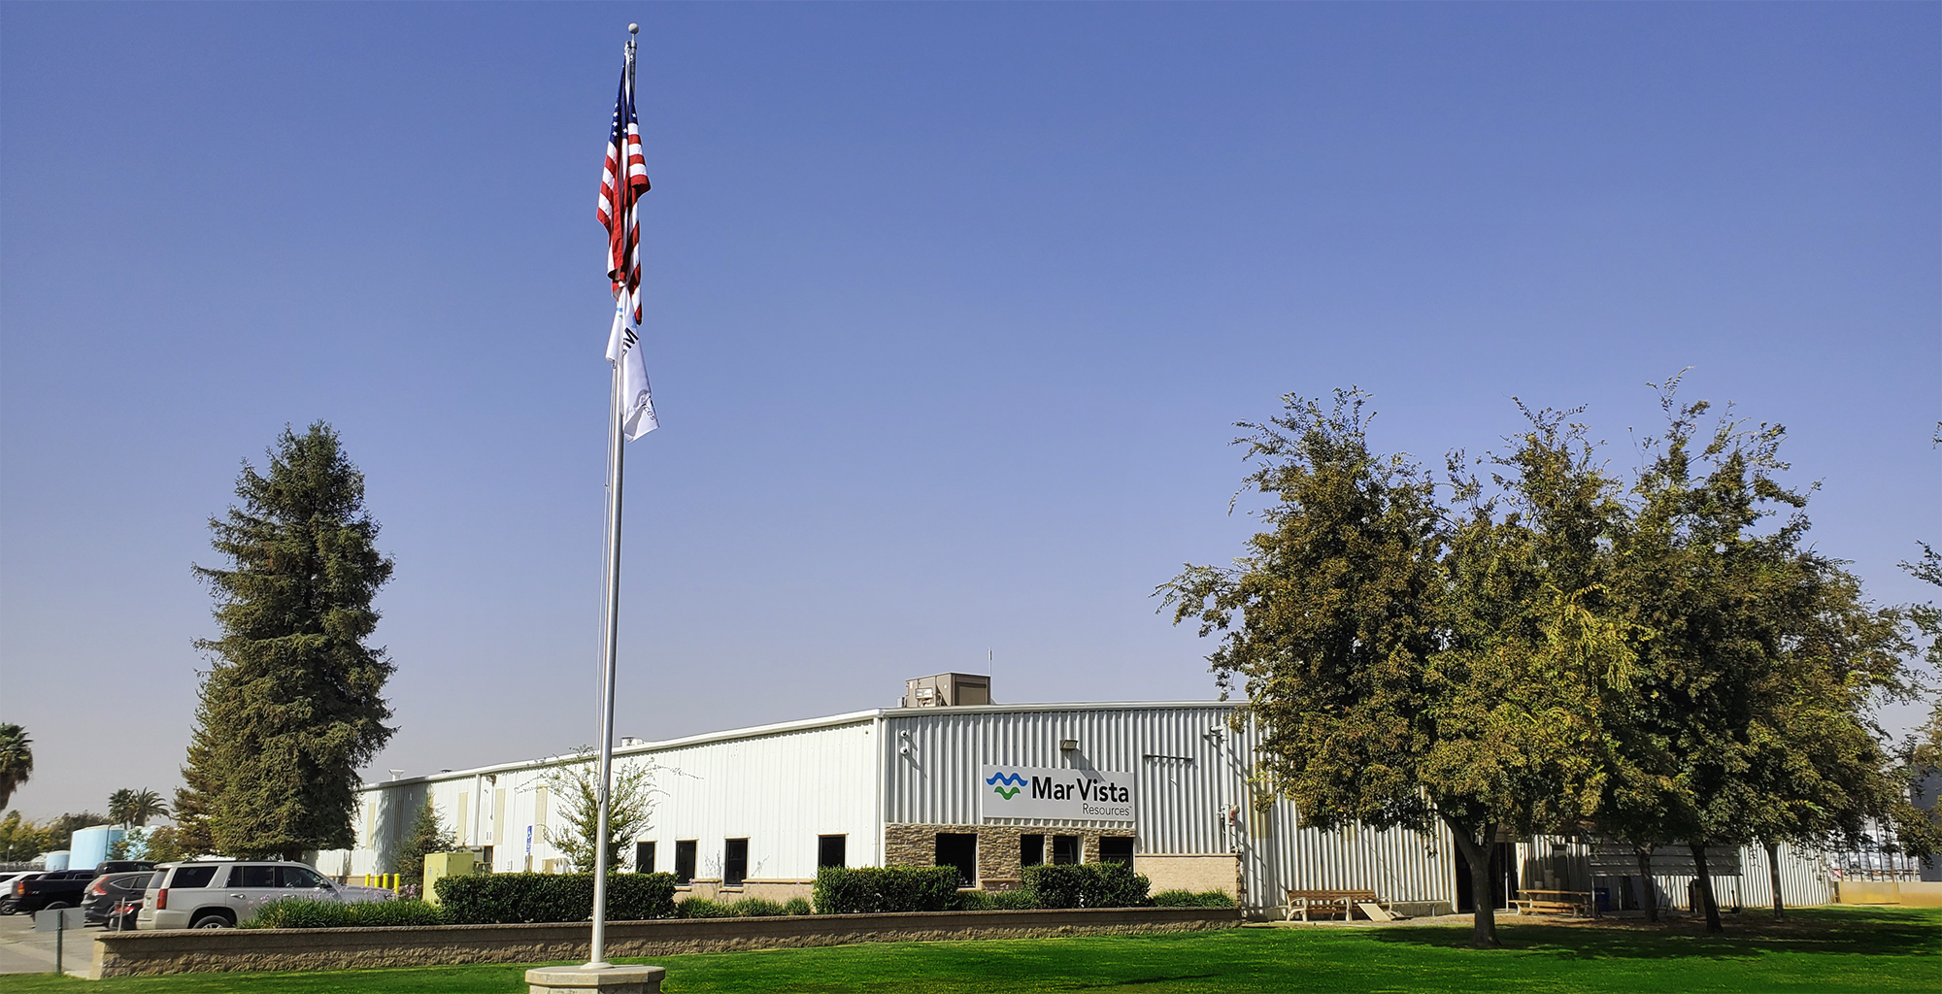
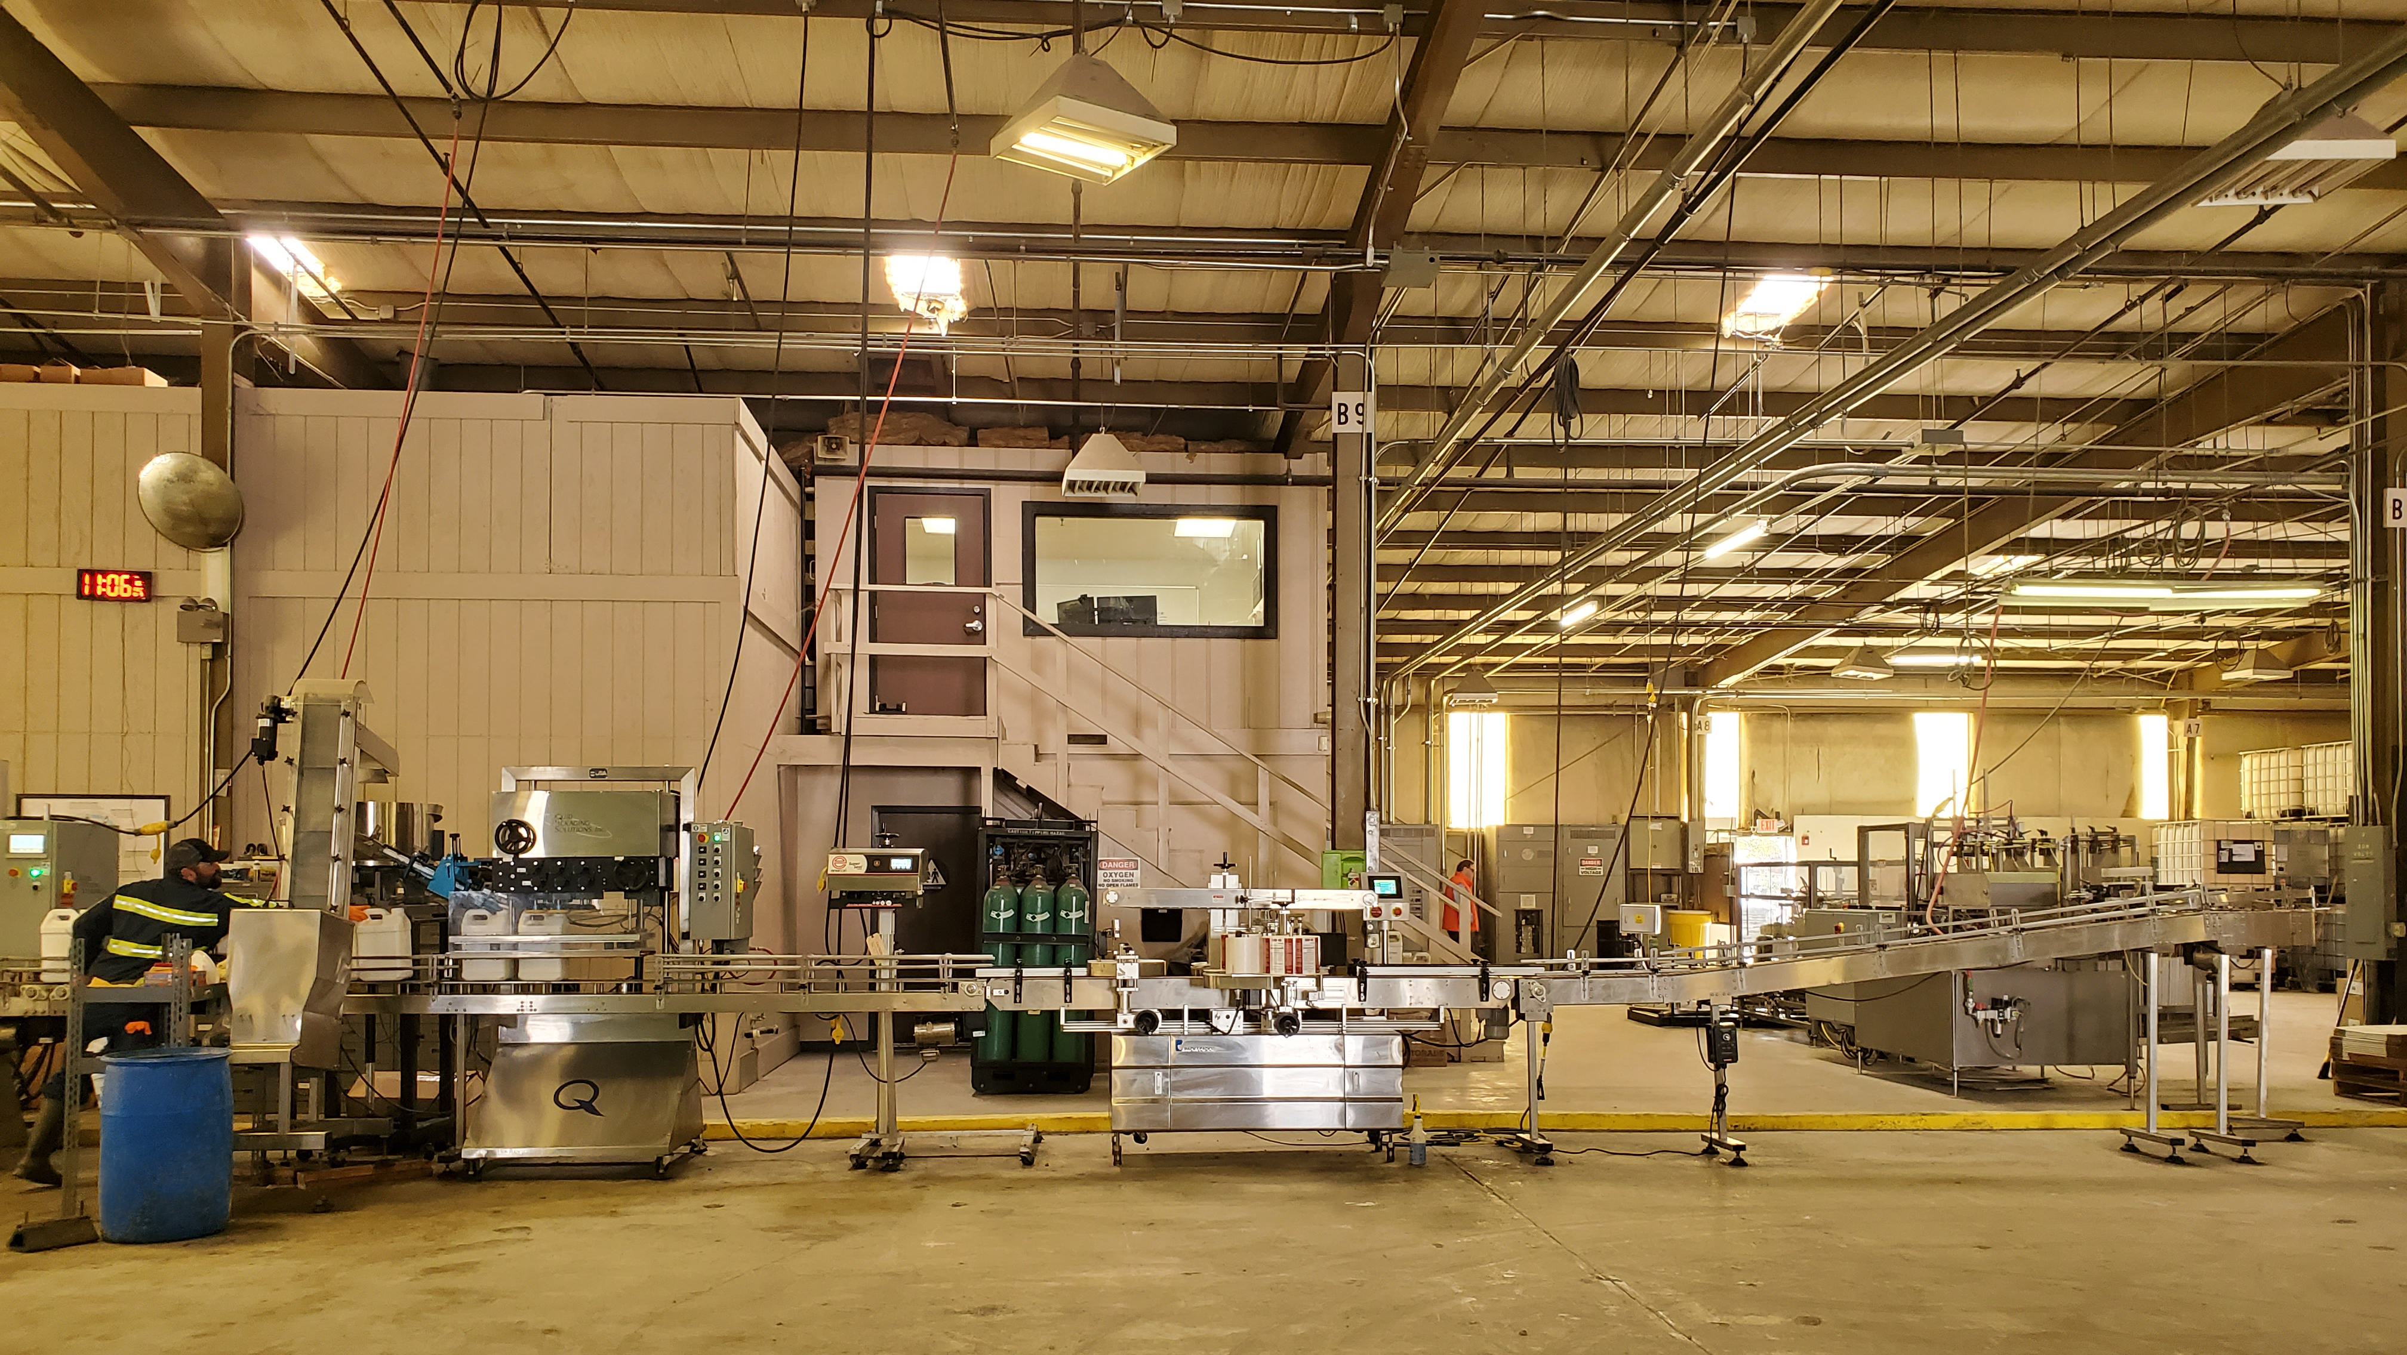
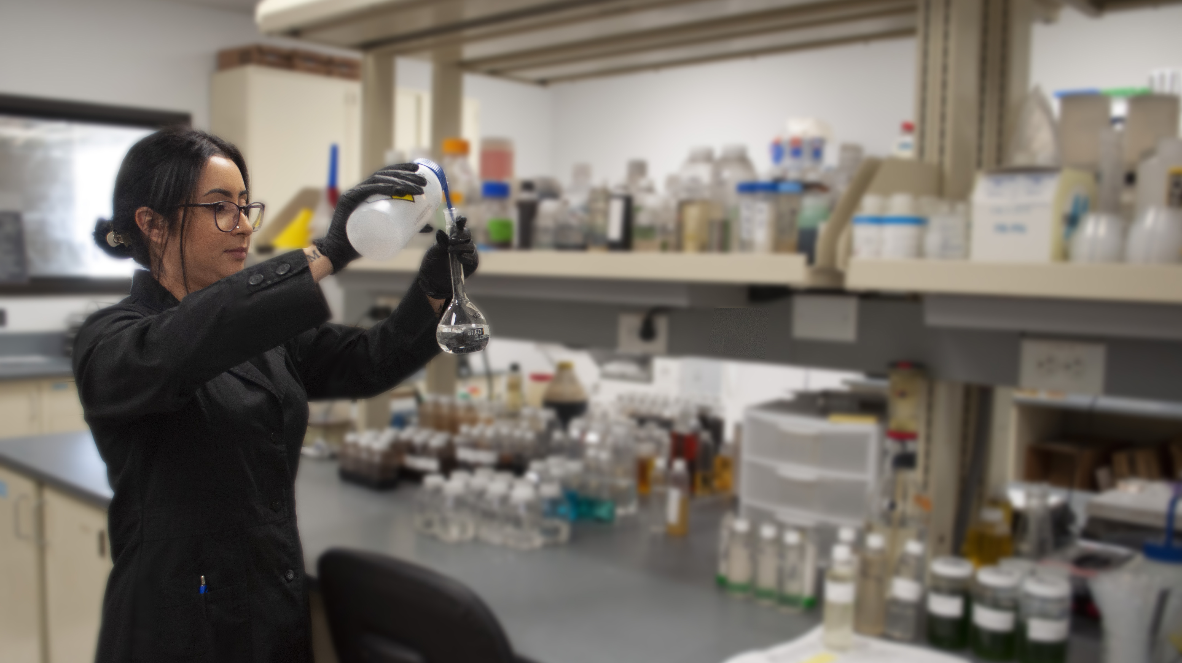
MAR VISTA RESOURCES HEADQUARTERS & PLANT
745 North Ave., Corcoran, CA (559) 992-4535 O |(559) 992-4537 F marvistaresources.com

Slide 27
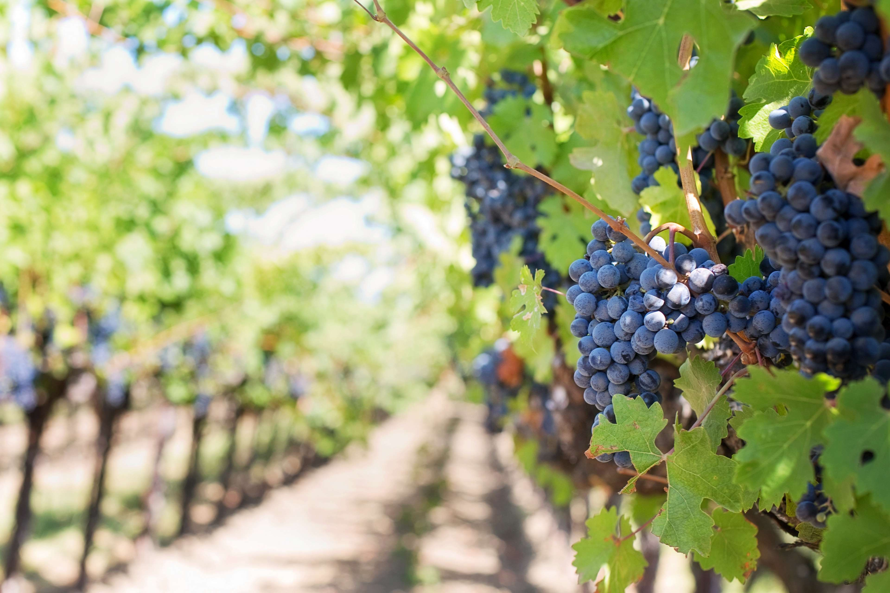
EF300 (Insecticide)
EF400 (Fungicide)
BacStop (Bactericide/Fungicide)
SoilShot (Nematicide/Fungicide)
Thank you for your business!
Contact for more information: (559) 992-4535 (O)
Jay Irvine, President (559) 288-2424 Cell jirvine@marvistaresources.com

